Slide 1

Data Engineering
On Microsoft Azure
Trainer: Maruti Makwana

Slide 2
Real-time stream processing with Stream Analytics
This sample uses following azure resources
Azure synapse analytics / Azure Databricks
Stream analytics job
Event Hub
Storage account

Slide 3
Scenario
Contoso Auto is collecting vehicle telemetry and wants to use Event Hubs to rapidly ingest and store the data in its raw form, then do some processing in real-time.
In the end, they want to create a dashboard that automatically updates with new data as it flows in after being processed.
What they would like to see on the dashboard are various visualizations of detected anomalies, like engines overheating, abnormal oil pressure, and aggressive driving, using components such as a map to show anomalies related to cities, as well as various charts and graphs depicting this information in a clear way.

Slide 4
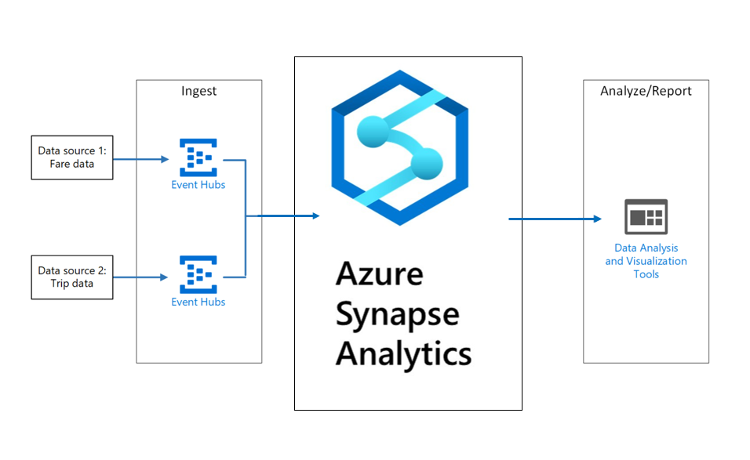
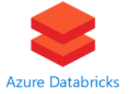

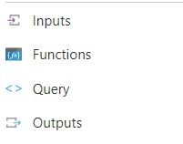

?

Slide 5
Azure Event Hubs is a Big Data streaming platform and event ingestion service, capable of receiving and processing millions of events per second.
We are using it to temporarily store vehicle telemetry data that is processed and ready to be sent to the real-time dashboard. As data flows into Event Hubs, Azure Stream Analytics will query the data, applying aggregates and tagging anomalies, then send it to Azure Synapse Analytics.

Slide 6
In this experience, you will use Azure Event Hubs to ingest streaming vehicle telemetry data as the entry point to a real-time analytics pipeline built on Event Hubs, Azure Stream Analytics, and Azure Synapse Analytics/Azure databricks.
Azure Stream Analytics extracts the vehicle sensor data from Event Hubs, performs aggregations over windows of time, then sends the aggregated data to Azure Synapse Analytics for data analysis. A vehicle telemetry data generator will be used to send vehicle telemetry data to Event Hubs.

Slide 7
?

Slide 8
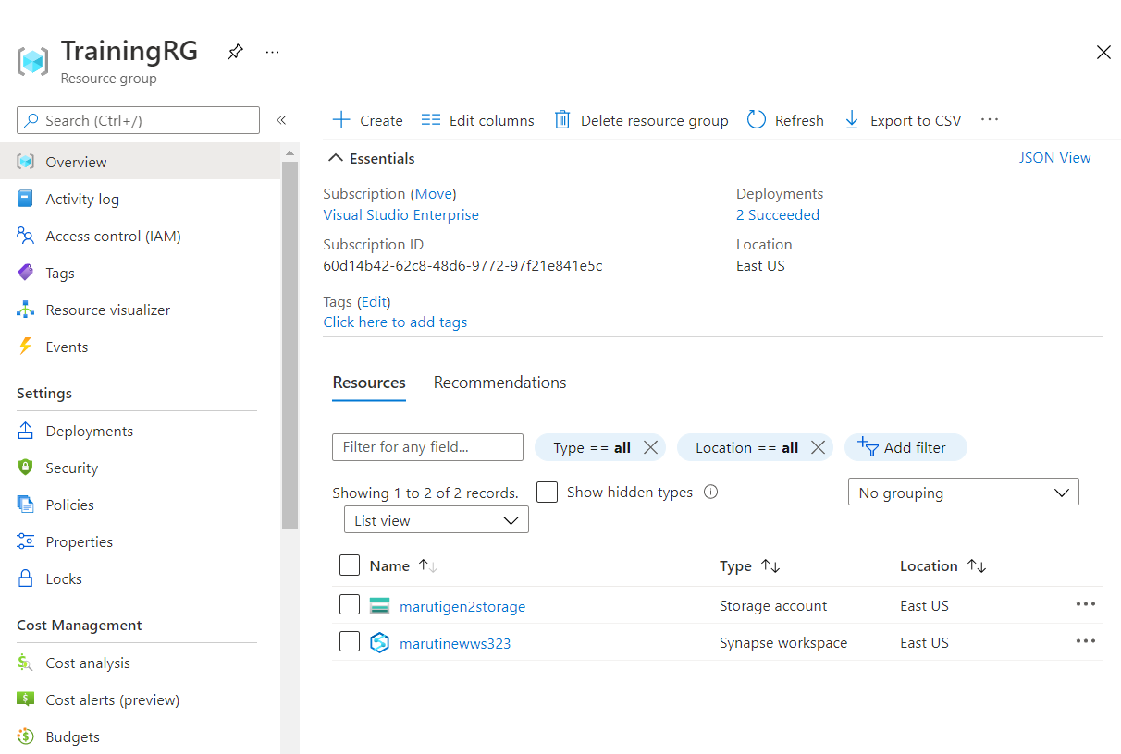

Slide 9
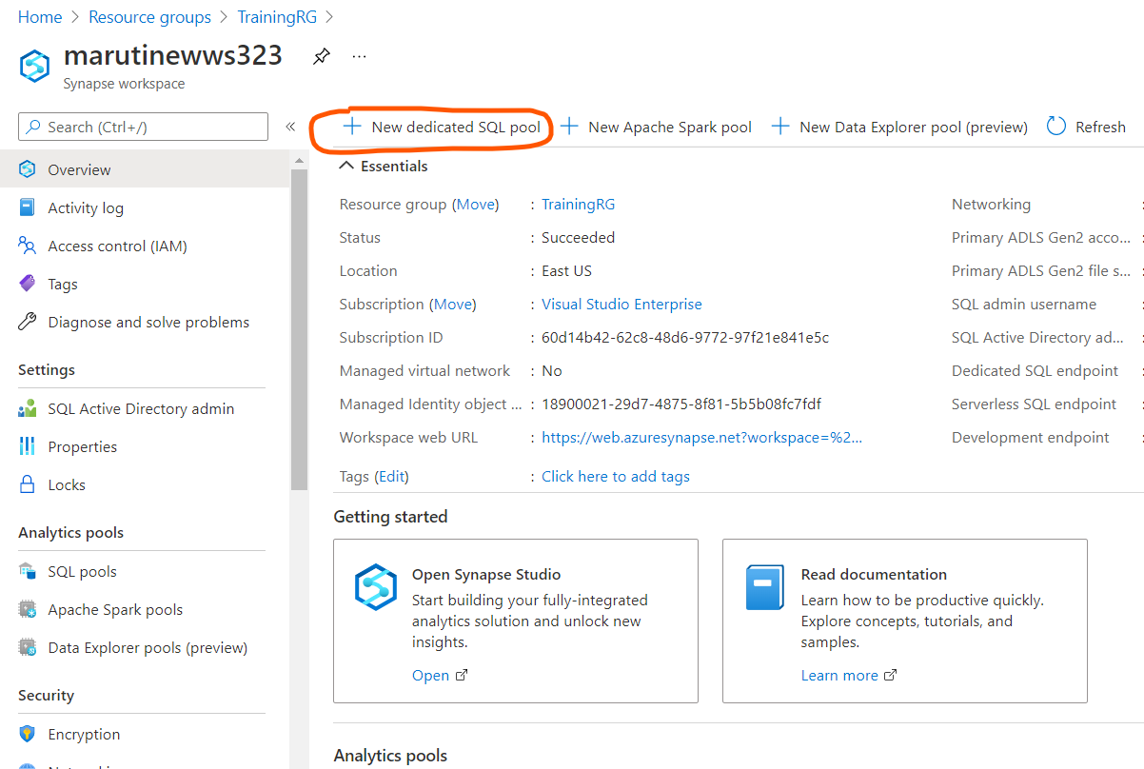

Slide 10
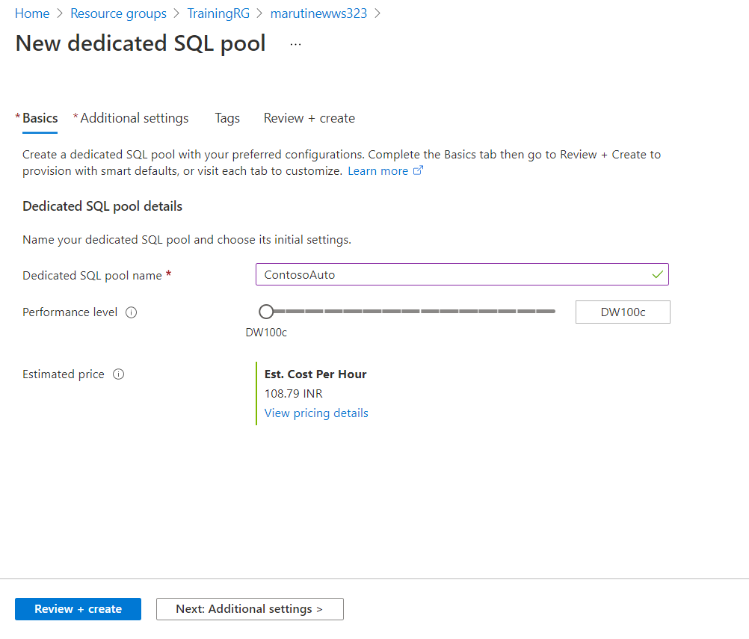

Slide 11
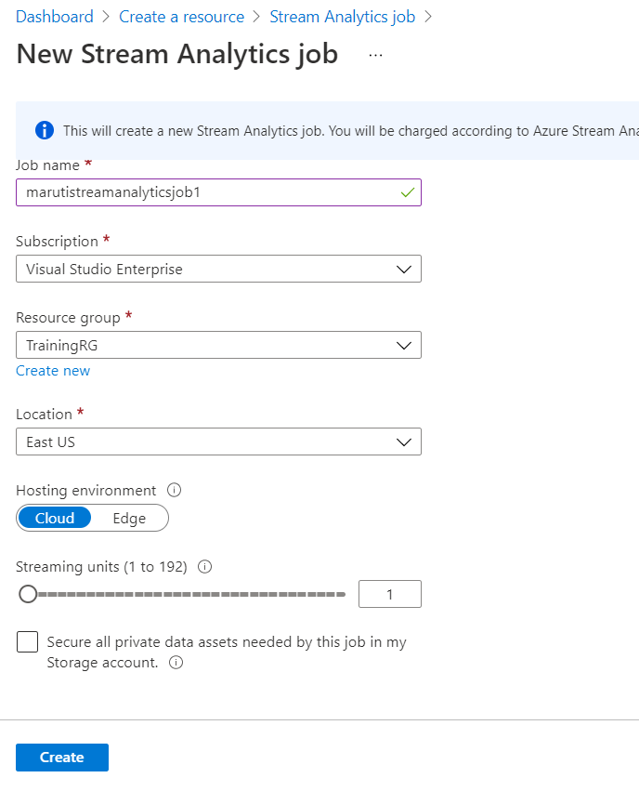

Slide 12
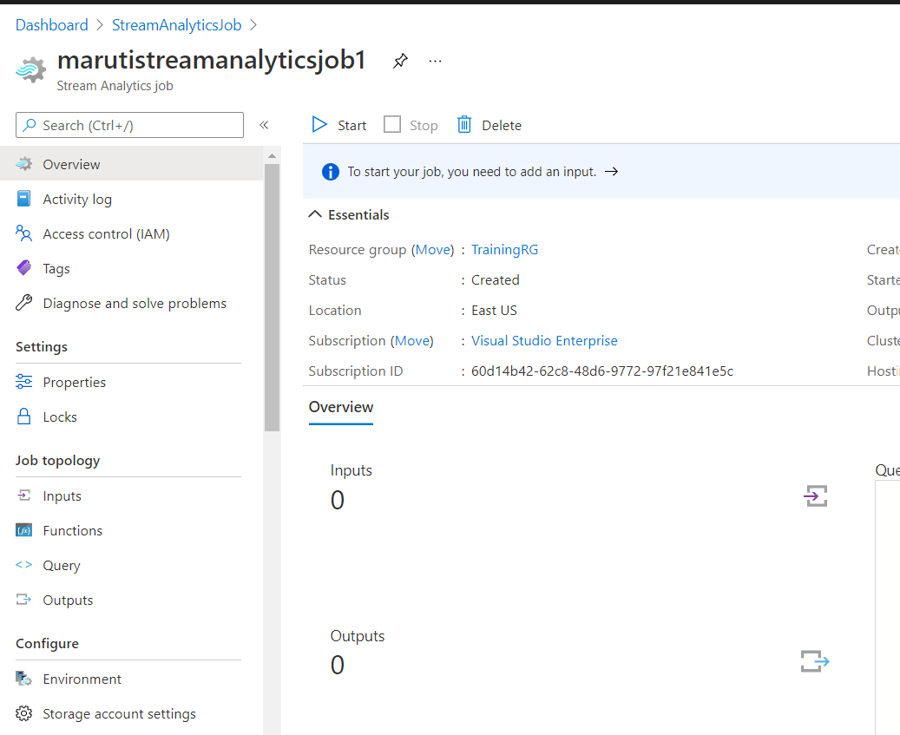

Slide 13
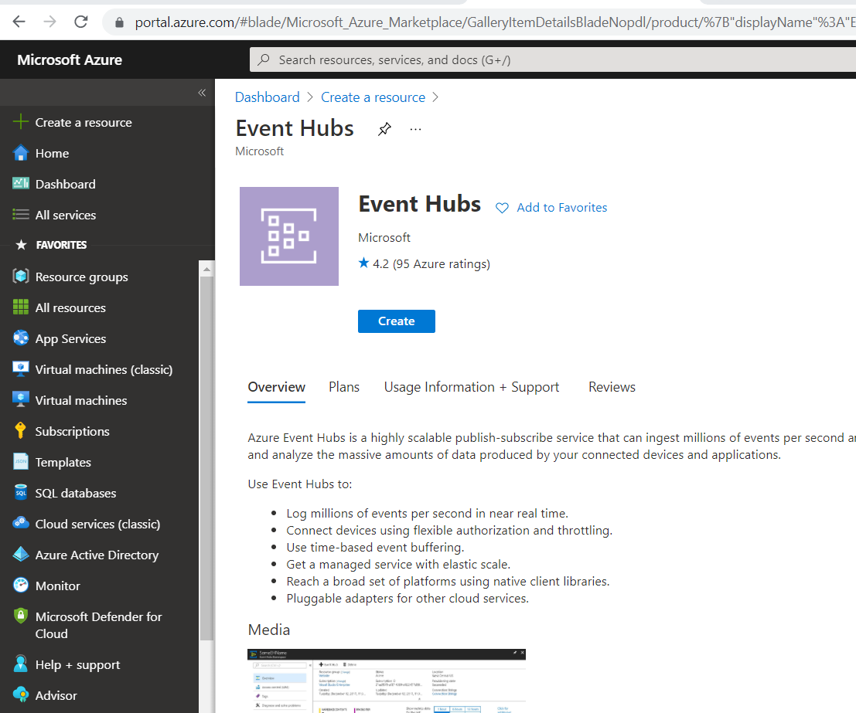

Slide 14
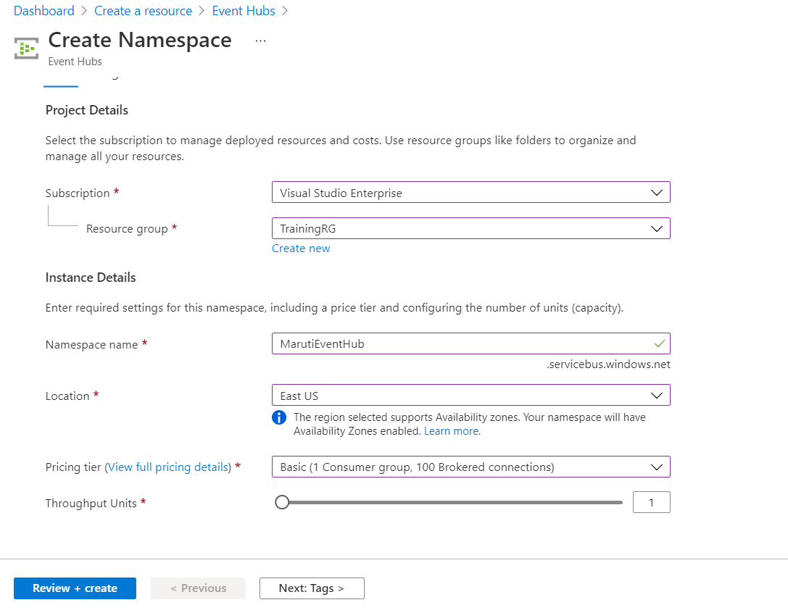

Slide 15
Azure Event Hubs is a Big Data streaming platform and event ingestion service, capable of receiving and processing millions of events per second.
We are using it to temporarily store vehicle telemetry data that is processed and ready to be sent to the real-time dashboard. As data flows into Event Hubs, Azure Stream Analytics will query the data, applying aggregates and tagging anomalies, then send it to Azure Synapse Analytics.

Slide 16
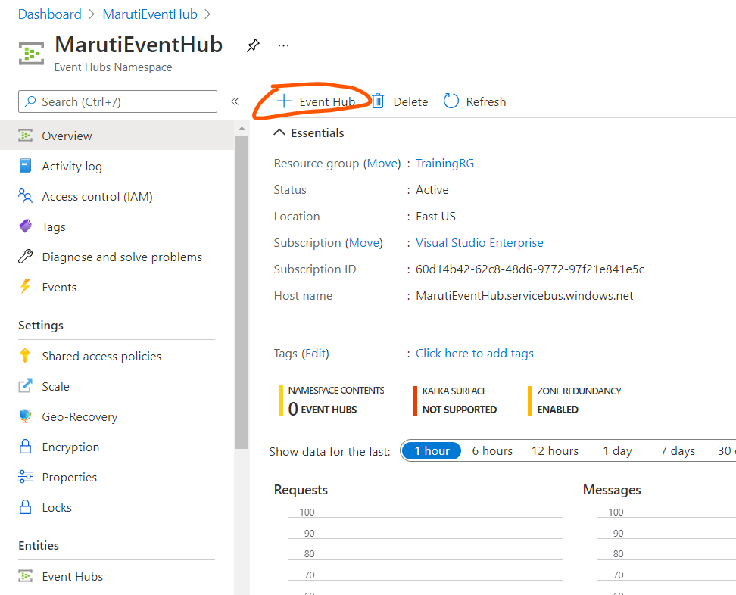

Slide 17
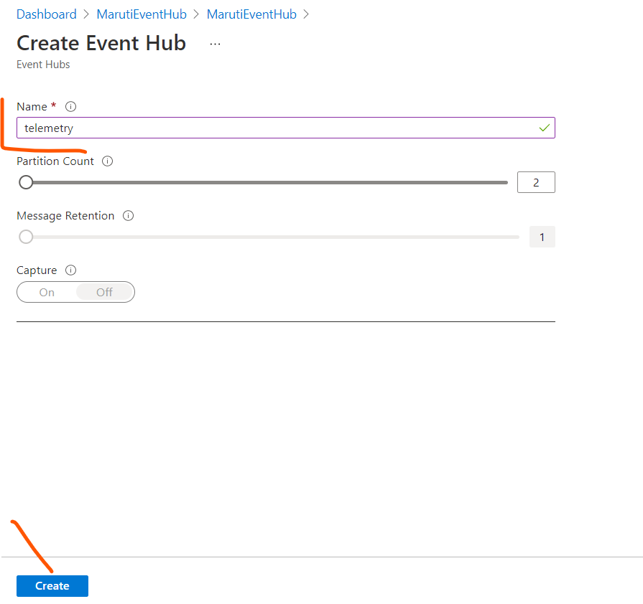

Slide 18
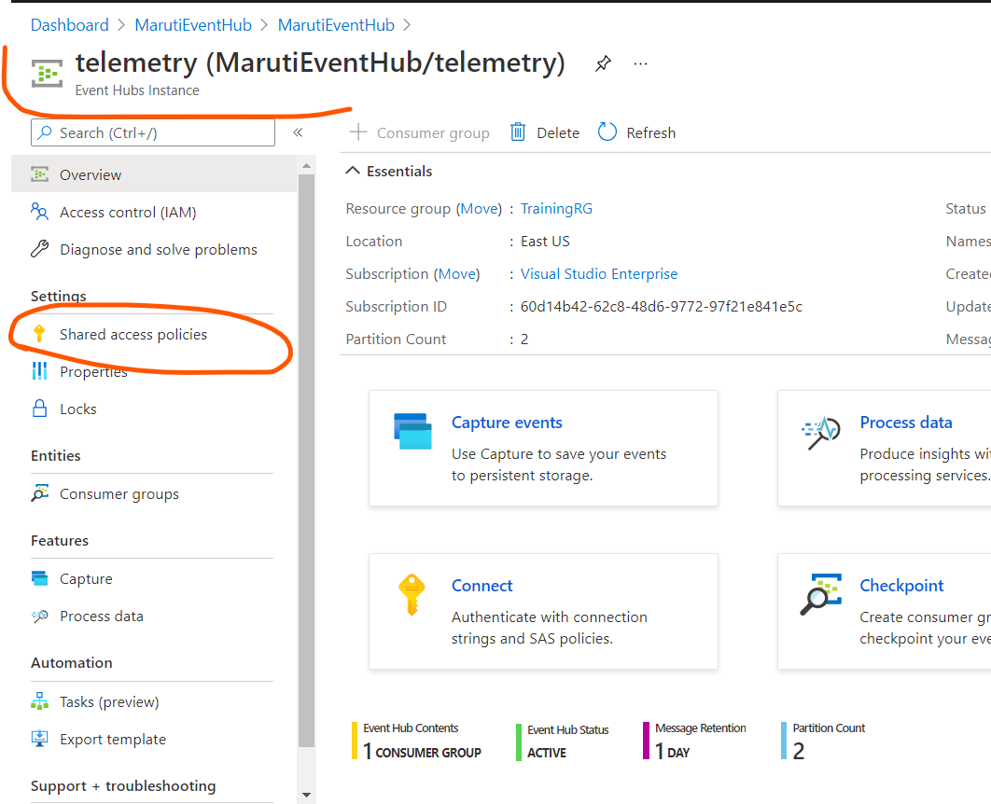

Slide 19
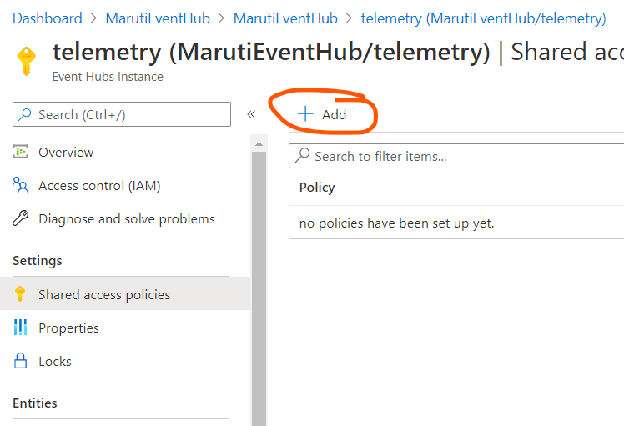

Slide 20
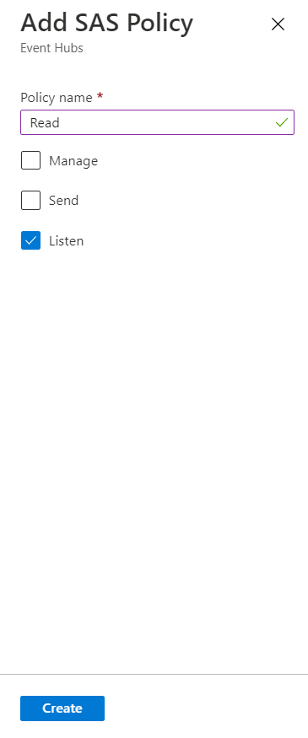
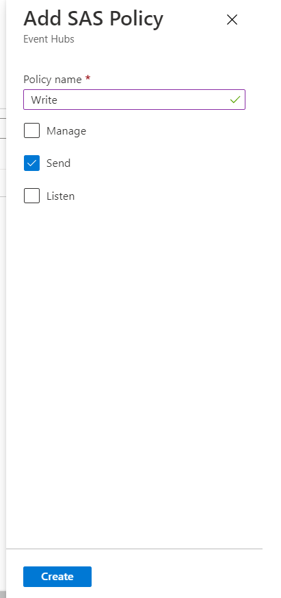

Slide 21
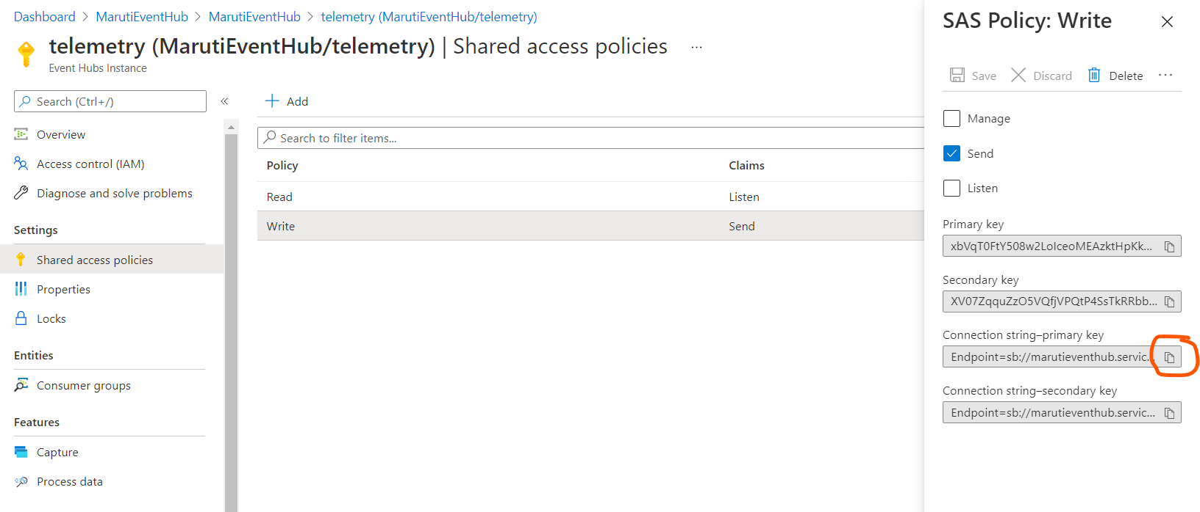
Endpoint=sb://marutieventhub.servicebus.windows.net/;SharedAccessKeyName=Write;SharedAccessKey=xbVqT0FtY508w2LoIceoMEAzktHpKkDPoH5zHfQbnYE=;EntityPath=telemetry

Slide 22
Configure Synapse Analytics
n this task, you will create a table in a Synapse dedicated SQL pool to store aggregate vehicle data provided by a Stream Analytics job that processes vehicle telemetry ingested by Event Hubs.

Slide 23
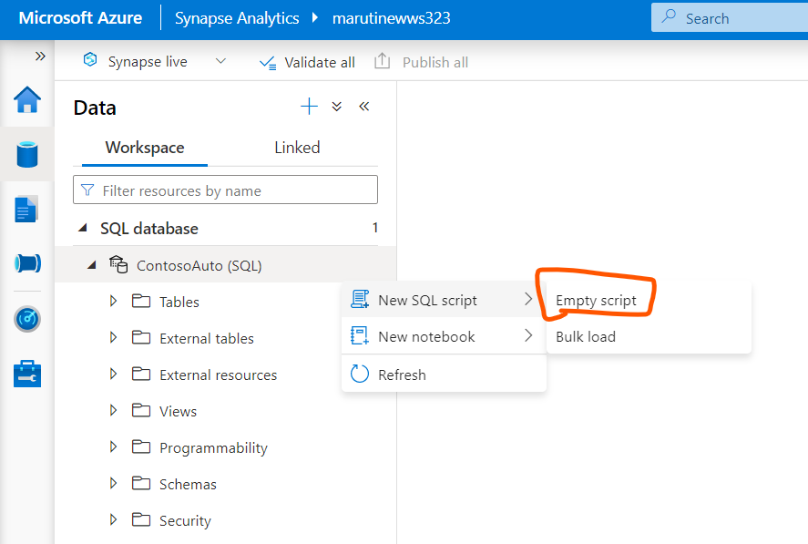

Slide 24
CREATE TABLE dbo.VehicleAverages
(
[AverageEngineTemperature] [float] NOT NULL,
[AverageSpeed] [float] NOT NULL,
[Snapshot] [datetime] NOT NULL
)
WITH
(
DISTRIBUTION = ROUND_ROBIN,
CLUSTERED COLUMNSTORE INDEX
)
GO
CREATE TABLE dbo.VehicleAverages ( [AverageEngineTemperature] [float] NOT NULL, [AverageSpeed] [float] NOT NULL, [Snapshot] [datetime] NOT NULL ) WITH ( DISTRIBUTION = ROUND_ROBIN, CLUSTERED COLUMNSTORE INDEX ) GO

Slide 25
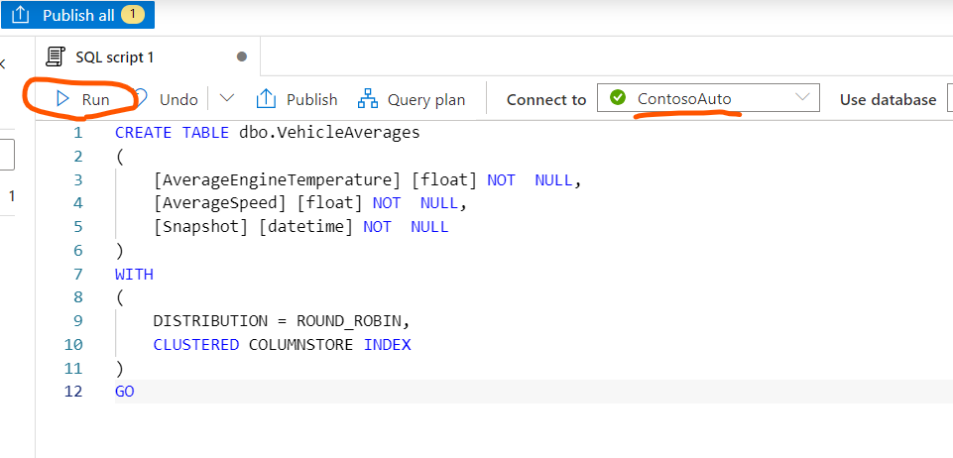

Slide 26
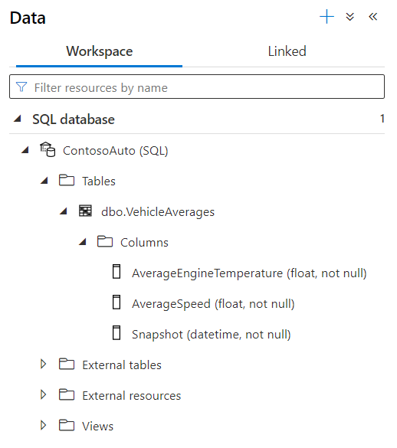

Slide 27
Configure Stream Analytics
Azure Stream Analytics is an event-processing engine that allows you to examine high volumes of data streaming from devices. Incoming data can be from devices, sensors, web sites, social media feeds, applications, and more.
It also supports extracting information from data streams, identifying patterns, and relationships. You can then use these patterns to trigger other actions downstream, such as create alerts, feed information to a reporting tool, or store it for later use.
In this task, you will configure Stream Analytics to use the event hub you created as a source, query and analyze that data.

Slide 28
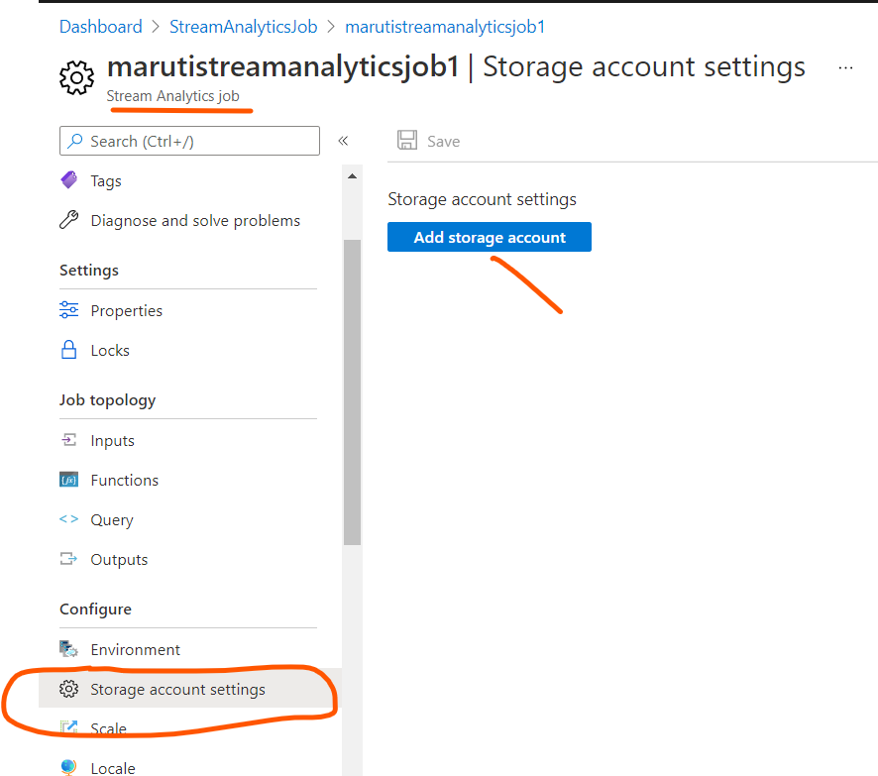

Slide 29
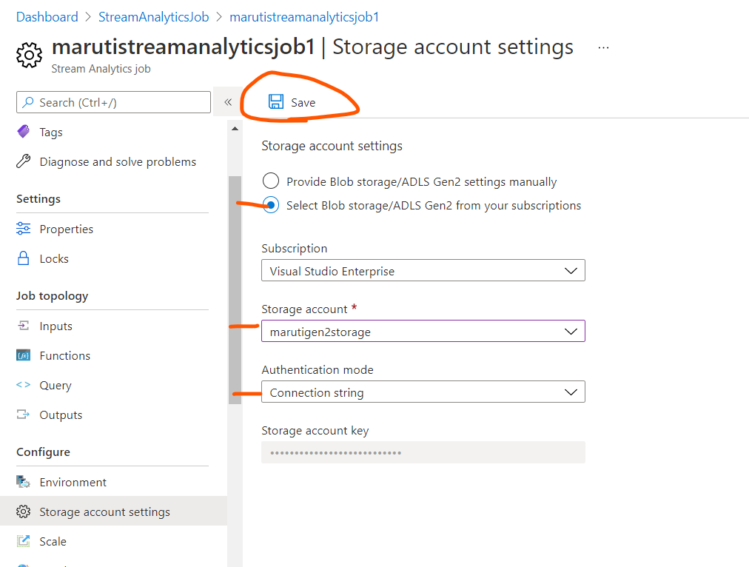

Slide 30
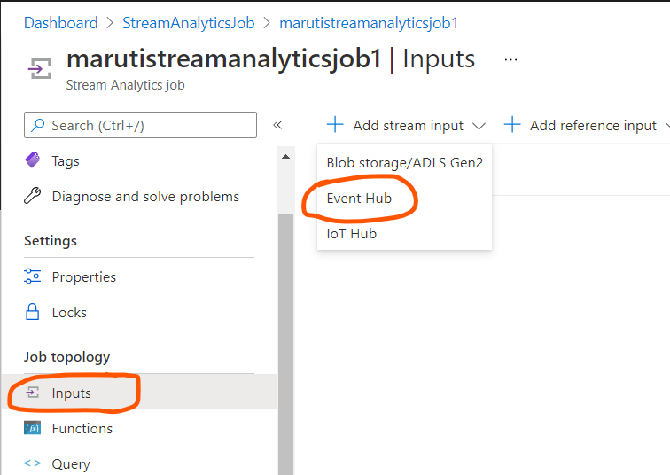

Slide 31
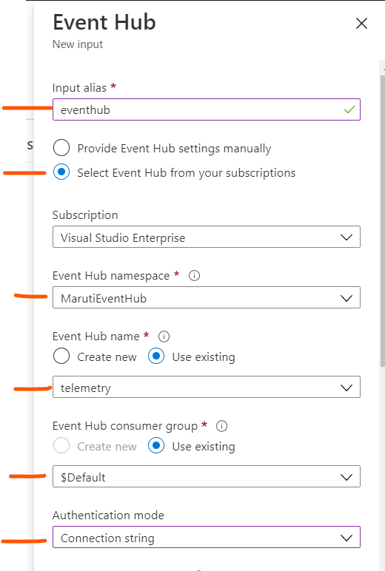
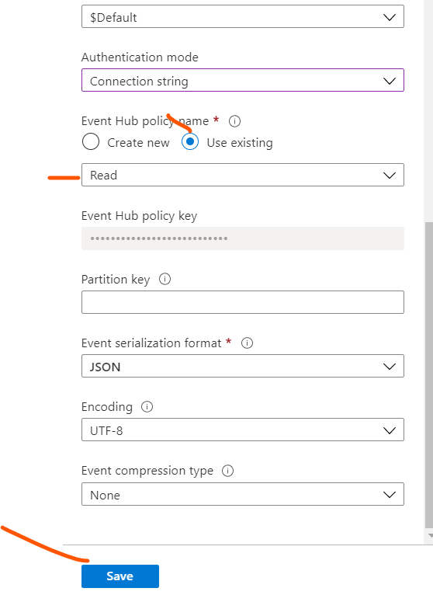

Slide 32
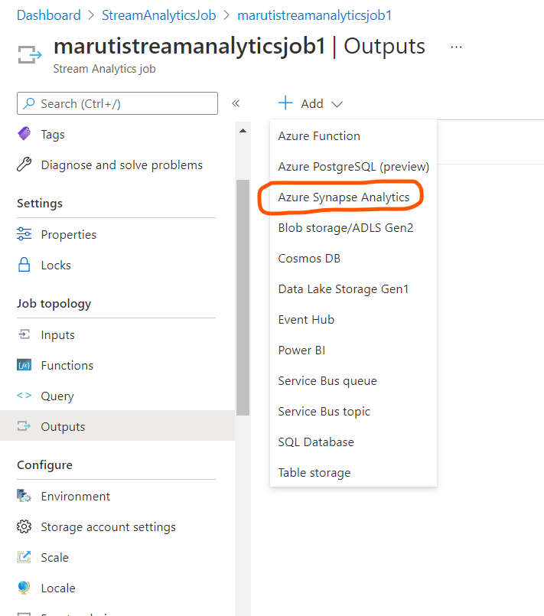

Slide 33
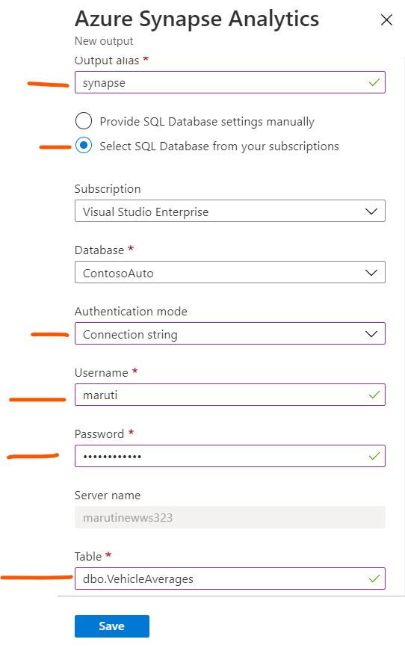

Slide 34
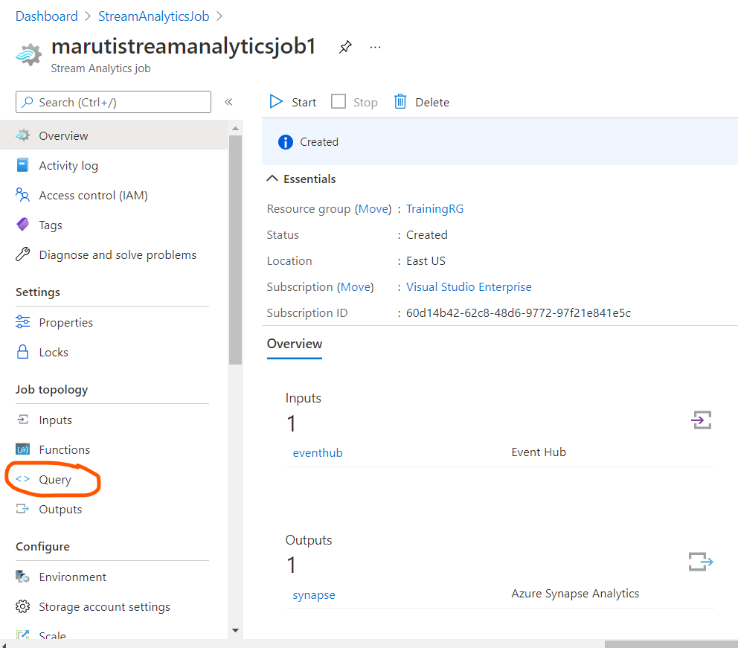

Slide 35
WITH
VehicleAverages AS (
select
AVG(engineTemperature) averageEngineTemperature,
AVG(speed) averageSpeed,
System.TimeStamp() as snapshot
FROM
eventhub TIMESTAMP BY [timestamp]
GROUP BY
TumblingWindow(Duration(minute, 2))
)
-- INSERT INTO Gen2 Storage
SELECT
*
INTO
adlsgen2
FROM
VehicleAverages

Slide 36
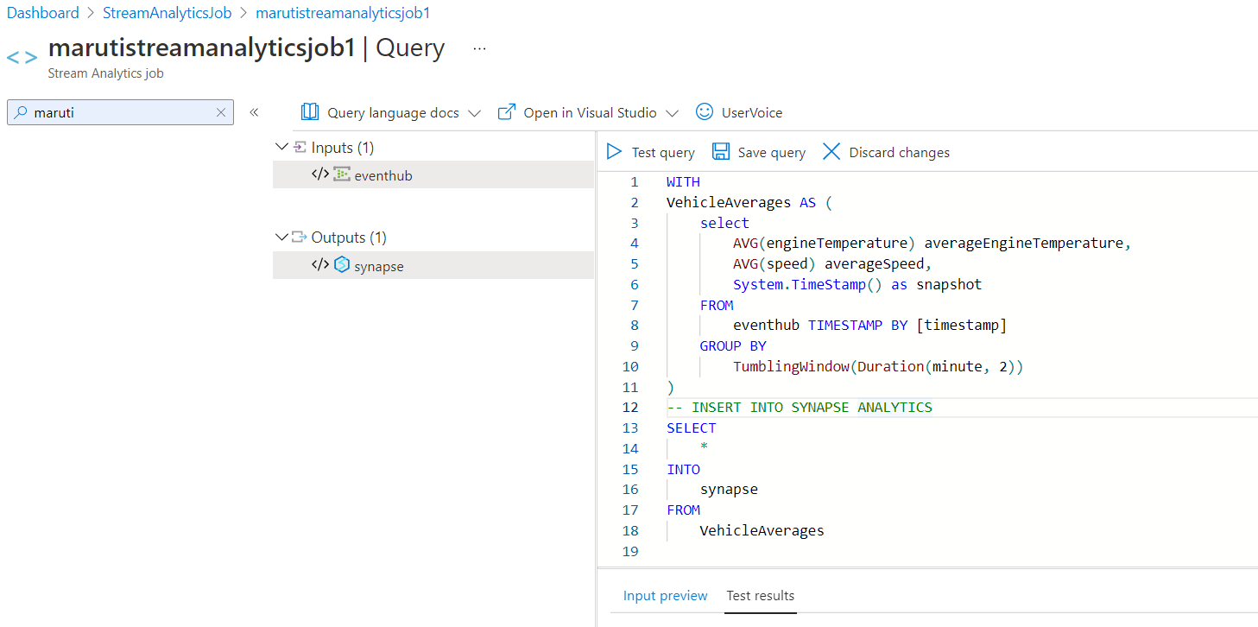
The query averages the engine temperature and speed over a two second duration. The query aggregates the average engine temperature and speed of all vehicles over the past two minutes, using TumblingWindow(Duration(minute, 2)), and outputs these fields to the synapse output.

Slide 37
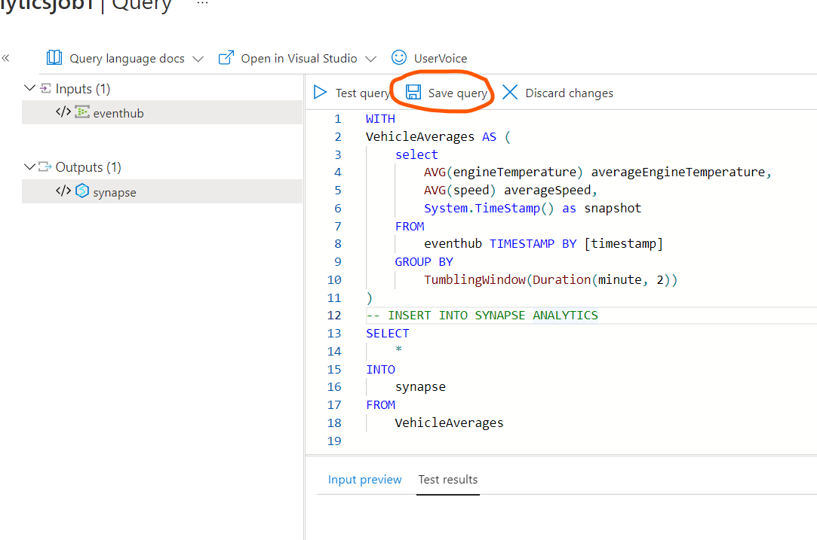

Slide 38
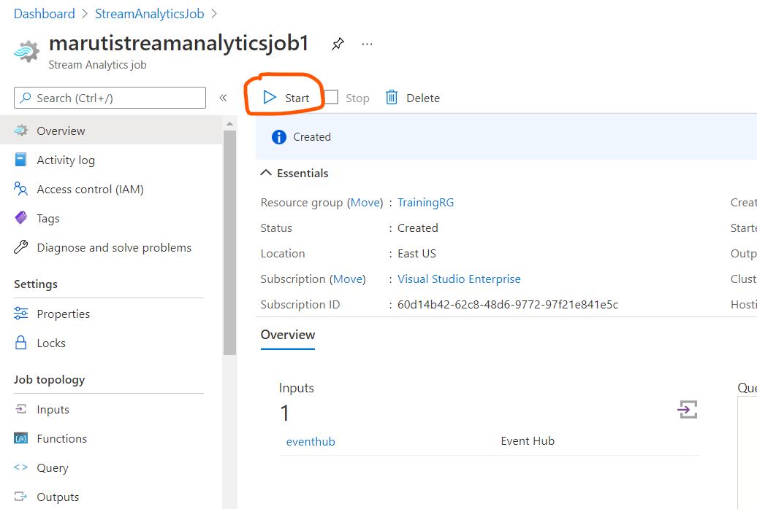

Slide 39
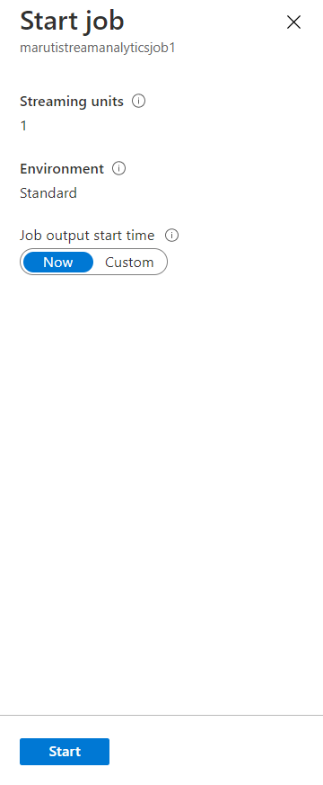
This will start the Stream Analytics job so it will be ready to start processing and sending your events to Azure Synapse Analytics.

Slide 40

Generate and aggregate data
Extract this file and open appsettings.json

Slide 41
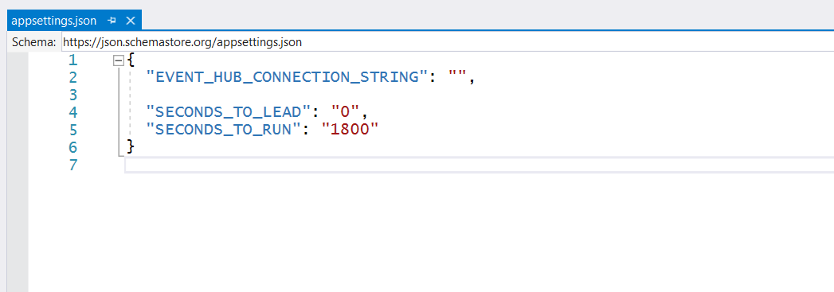
SECONDS_TO_LEAD is the amount of time to wait before sending vehicle telemetry data. Default value is 0.
SECONDS_TO_RUN is the maximum amount of time to allow the generator to run before stopping transmission of data.
The default value is 1800. Data will also stop transmitting when you enter Ctrl+C while the generator is running, or if you close the window.

Slide 42
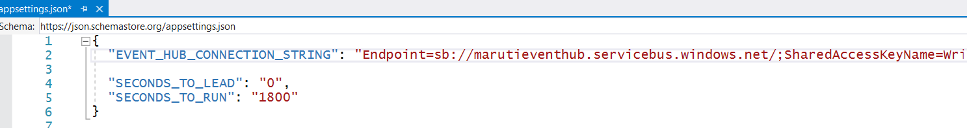
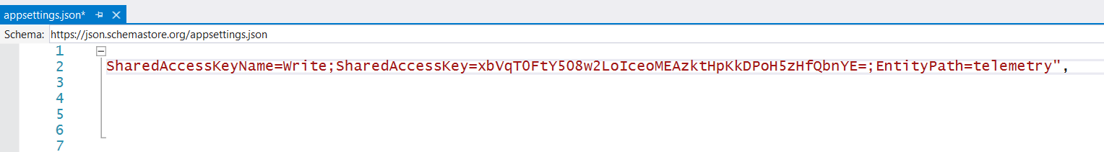
{
"EVENT_HUB_CONNECTION_STRING": "Endpoint=sb://marutieventhub.servicebus.windows.net/;SharedAccessKeyName=Write;SharedAccessKey=xbVqT0FtY508w2LoIceoMEAzktHpKkDPoH5zHfQbnYE=;EntityPath=telemetry",
"SECONDS_TO_LEAD": "0",
"SECONDS_TO_RUN": "1800"
}

Slide 43

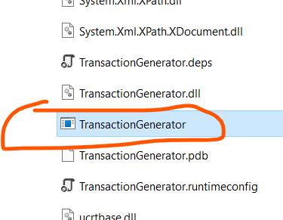

Slide 44
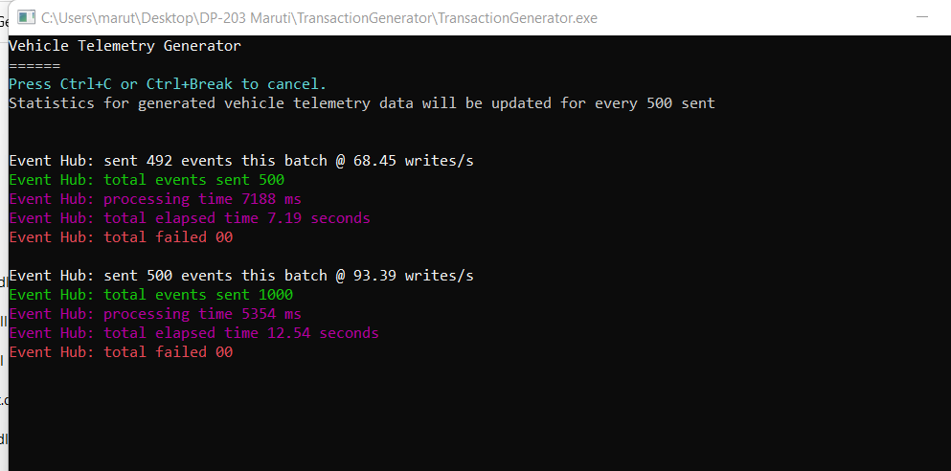
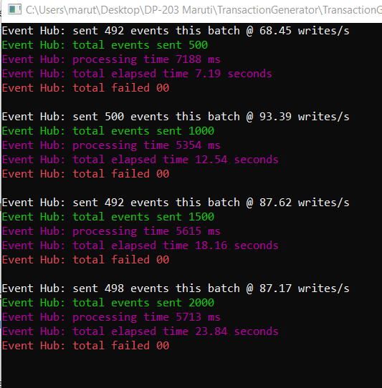

Slide 45
Wait for 3 minutes so that this can send enough data

Slide 46
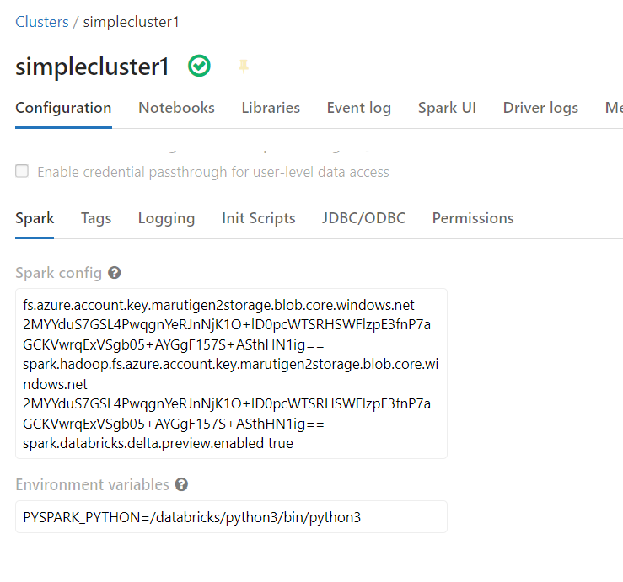
fs.azure.account.key.marutigen2storage.blob.core.windows.net 2MYYduS7GSL4PwqgnYeRJnNjK1O+lD0pcWTSRHSWFlzpE3fnP7aGCKVwrqExVSgb05+AYGgF157S+ASthHN1ig== spark.hadoop.fs.azure.account.key.marutigen2storage.blob.core.windows.net 2MYYduS7GSL4PwqgnYeRJnNjK1O+lD0pcWTSRHSWFlzpE3fnP7aGCKVwrqExVSgb05+AYGgF157S+ASthHN1ig== spark.databricks.delta.preview.enabled true

Slide 47
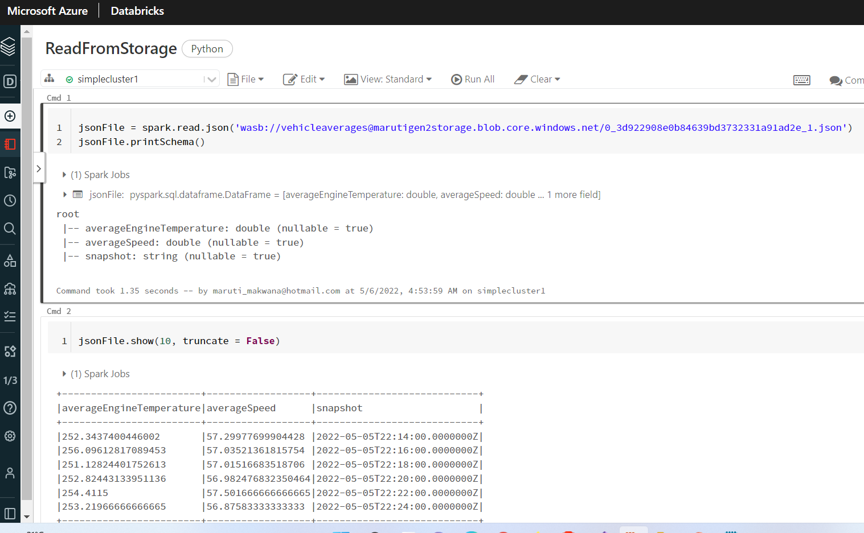

Slide 48
View aggregate data in Synapse Analytics

Slide 49
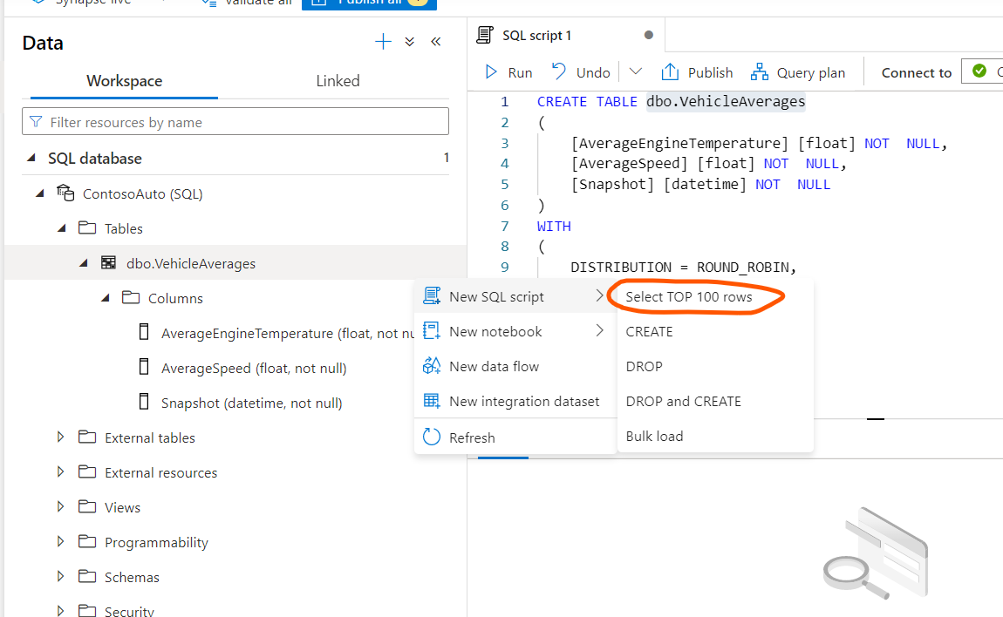

Slide 50
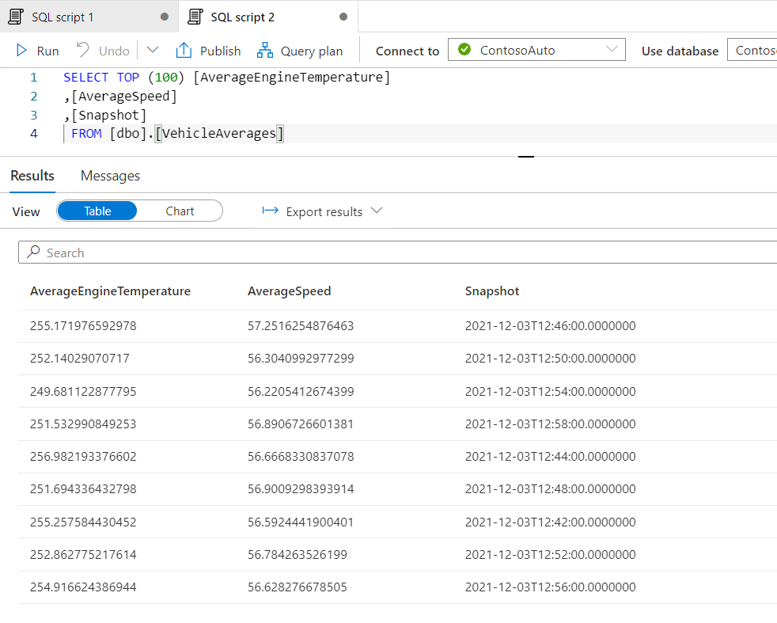

Slide 51
